Slide 1
Correlation
Md. Ismail Hossain Riday

Slide 2
Correlation
Association
Connection
Relationship

Slide 3
Correlation
Relationship between two or more variables

Slide 4
Correlation
Relationship between two or more variables
Which gives us strength or degree

Slide 5
Correlation
Relationship between two or more variables
Which gives us strength or degree and direction of association

Slide 6
Correlation
Relationship between two or more variables which gives us strength or degree and direction of association

Slide 7
Types of Correlation
On the basis of direction
Positive correlation
On the basis of variables
Simple correlation
On the basis of linearity
Negative correlation
Multiple correlation
Linear correlation
Non-Linear correlation

Slide 8
Types of Correlation
On the basis of direction
Positive correlation
On the basis of variables
Simple correlation
On the basis of linearity
Negative correlation
Multiple correlation
Linear correlation
Non-Linear correlation

Slide 9
Types of Correlation
On the basis of direction
Positive correlation
On the basis of variables
Simple correlation
On the basis of linearity
Negative correlation
Multiple correlation
Linear correlation
Non-Linear correlation

Slide 10
Types of Correlation
On the basis of direction
Positive correlation
On the basis of variables
Simple correlation
On the basis of linearity
Negative correlation
Multiple correlation
Linear correlation
Non-Linear correlation

Slide 11
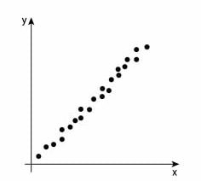
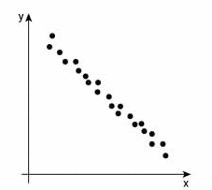
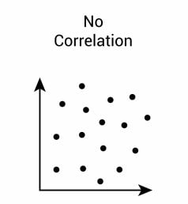
Types of Correlation
On the basis of direction
Positive correlation
On the basis of variables
Simple correlation
On the basis of linearity
Negative correlation
Multiple correlation
Linear correlation
Non-Linear correlation

Slide 12
Types of Correlation
On the basis of direction
Positive correlation
On the basis of variables
Simple correlation
On the basis of linearity
Negative correlation
Multiple correlation
Linear correlation
Non-Linear correlation

Slide 13
Types of Correlation
On the basis of direction
Positive correlation
On the basis of variables
Simple correlation (Two variables)
On the basis of linearity
Negative correlation
Multiple correlation
Linear correlation
Non-Linear correlation

Slide 14
Types of Correlation
On the basis of direction
Positive correlation
On the basis of variables
Simple correlation
On the basis of linearity
Negative correlation
Multiple correlation (More than two)
Linear correlation
Non-Linear correlation

Slide 15
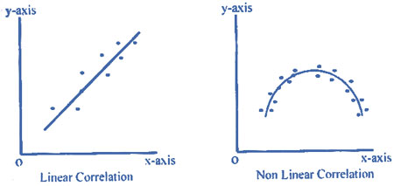
Types of Correlation
On the basis of direction
Positive correlation
On the basis of variables
Simple correlation
On the basis of linearity
Negative correlation
Multiple correlation
Linear correlation
Non-Linear correlation

Slide 16
Measures
Correlation can be measured by

Slide 17
Measures
Correlation can be measured by
Scatter Diagram

Slide 18
Measures
Correlation can be measured by
Scatter Diagram
Karl Pearson’s Correlation Coefficient

Slide 19
Measures
Correlation can be measured by
Scatter Diagram
Karl Pearson’s Correlation Coefficient
Spearman Rank Correlation Coefficient

Slide 20
Measures
Correlation can be measured by
Scatter Diagram
Karl Pearson’s Correlation Coefficient
Spearman Rank Correlation Coefficient
Method of Least Square

Slide 21
Measures
Correlation can be measured by
Scatter Diagram
Karl Pearson’s Correlation Coefficient
t

Slide 22
Scatter Diagram
Draw the scatter diagram
Is there any relationship between “Age” and “Glucose Level”?
Age | Glucose Level
43 | 99
21 | 65
25 | 79
42 | 75
57 | 87

Slide 23
Scatter Diagram
Draw the scatter diagram
Is there any relationship between “Age” and “Glucose Level”?
Age | Glucose Level
43 | 99
21 | 65
25 | 79
42 | 75
57 | 87

Slide 24
Scatter Diagram
Draw the scatter diagram
Is there any relationship between “Age” and “Glucose Level”?
Age | Glucose Level
43 | 99
21 | 65
25 | 79
42 | 75
57 | 87

Slide 25
Scatter Diagram
Draw the scatter diagram
Is there any relationship between “Age” and “Glucose Level”?
Age | Glucose Level
43 | 99
21 | 65
25 | 79
42 | 75
57 | 87
With the increase of age, the Glucose Level also increased. Thus, there is a positive correlation between “Age” and “Glucose Level”.

Slide 26
Limitations
Accurate degree and strength of correlation can not be obtained by scatter diagram.

Slide 27
Karl Pearson’s Correlation
Both variables are measured in interval or ratio scales

Slide 28
Karl Pearson’s Correlation
Both variables are measured in interval or ratio scales
Relationship between variables is linear

Slide 29
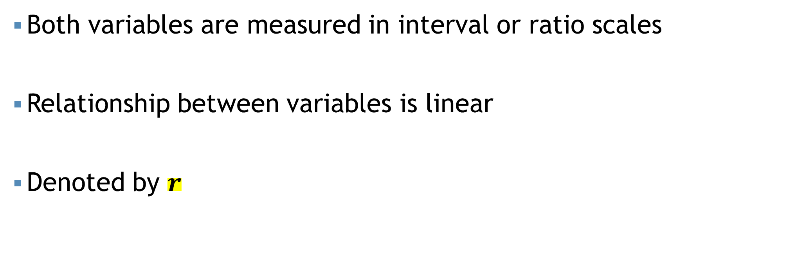
Karl Pearson’s Correlation
Both variables are measured in interval or ratio scales
Relationship between variables is linear
Denoted by $r$

Slide 30
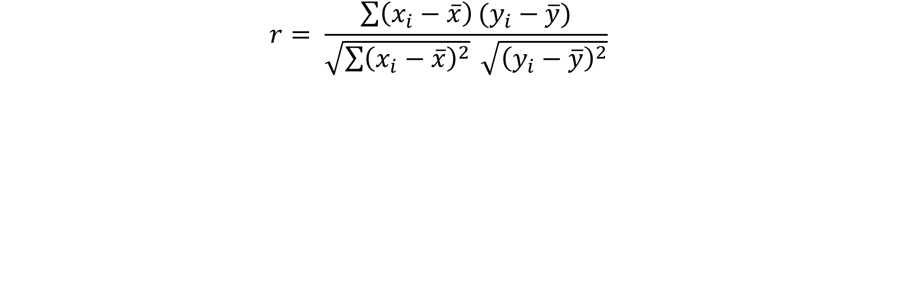
Karl Pearson’s Correlation
$$r= \frac{\sum{\left(x_{i}−\overline{x}\right)}(y_{i}−\overline{y})}{\sqrt{\sum{{\left(x_{i}−\overline{x}\right)}^{2}}} \sqrt{{\left(y_{i}−\overline{y}\right)}^{2}}}$$

Slide 31
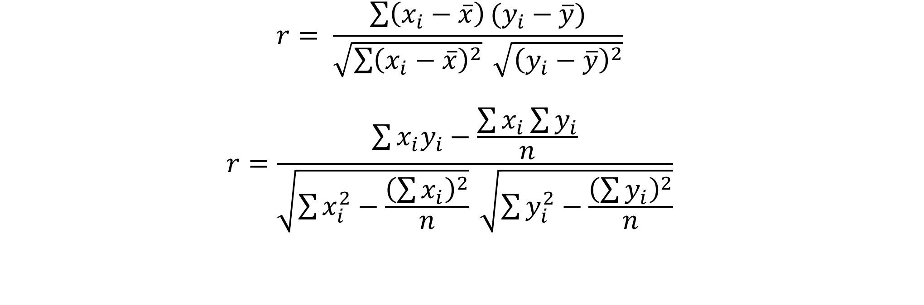
Karl Pearson’s Correlation
$$r= \frac{\sum{\left(x_{i}−\overline{x}\right)}(y_{i}−\overline{y})}{\sqrt{\sum{{\left(x_{i}−\overline{x}\right)}^{2}}} \sqrt{{\left(y_{i}−\overline{y}\right)}^{2}}}$$
$$r=\frac{\sum{x_{i}y_{i}}−\frac{\sum{x_{i}}\sum{y_{i}}}{n}}{\sqrt{\sum{x_{i}^{2}}−\frac{{\left(\sum{x_{i}}\right)}^{2}}{n}} \sqrt{\sum{y_{i}^{2}}−\frac{{\left(\sum{y_{i}}\right)}^{2}}{n}}}$$

Slide 32

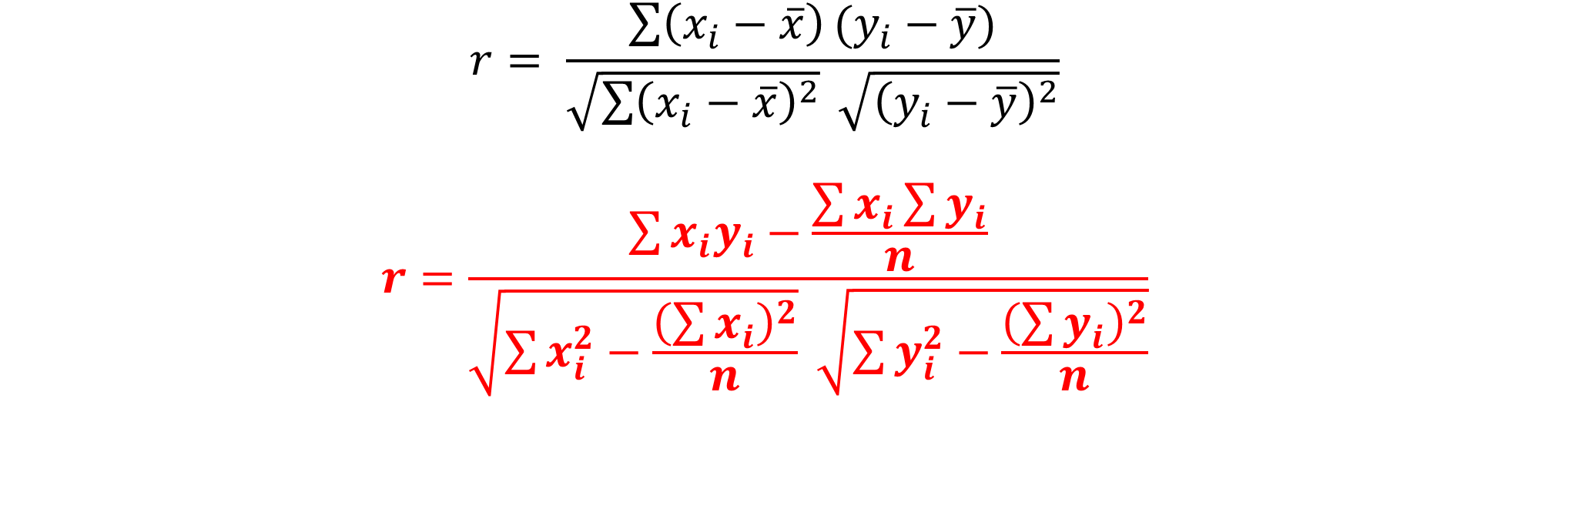


Karl Pearson’s Correlation
$$r= \frac{\sum{\left(x_{i}−\overline{x}\right)}(y_{i}−\overline{y})}{\sqrt{\sum{{\left(x_{i}−\overline{x}\right)}^{2}}} \sqrt{{\left(y_{i}−\overline{y}\right)}^{2}}}$$
$$r=\frac{\sum{x_{i}y_{i}}−\frac{\sum{x_{i}}\sum{y_{i}}}{n}}{\sqrt{\sum{x_{i}^{2}}−\frac{{\left(\sum{x_{i}}\right)}^{2}}{n}} \sqrt{\sum{y_{i}^{2}}−\frac{{\left(\sum{y_{i}}\right)}^{2}}{n}}}$$
Correlation | Negative | Positive
Weak | -0.29 to -0.10 | 0.10 to 0.29
Medium | -0.49 to -0.30 | 0.30 to 0.49
Moderate | -0.50 to -0.79 | 0.50 to 0.79
Strong | -1.00 to -0.80 | 0.80 to 1.00
Range of r is [-1 to +1]
If $r=+1$; Perfect positive correlation
If $r=−1$; Perfect negative correlation
If $r=0$; No correlation

Slide 33
Karl Pearson’s Correlation
Example: The monthly income and saving data for a sample of 10 garments workers are given below:
Income ($) | Savings ($)
60 | 5
66 | 7
66 | 8
66 | 9
68 | 11
68 | 12
70 | 14
72 | 16
74 | 21
80 | 27
Draw the scatter plot
Compute the correlation coefficient value with proper interpretation

Slide 34
Karl Pearson’s Correlation
Example: The monthly income and saving data for a sample of 10 garments workers are given below:
Income ($) | Savings ($)
60 | 5
66 | 7
66 | 8
66 | 9
68 | 11
68 | 12
70 | 14
72 | 16
74 | 21
80 | 27
Draw the scatter plot

Slide 35
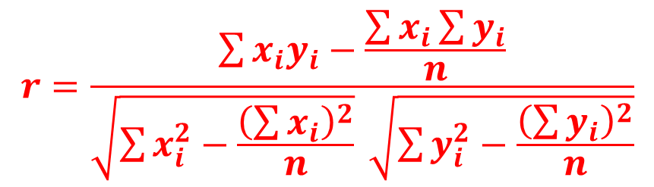
Cont.
$$r=\frac{\sum{x_{i}y_{i}}−\frac{\sum{x_{i}}\sum{y_{i}}}{n}}{\sqrt{\sum{x_{i}^{2}}−\frac{{\left(\sum{x_{i}}\right)}^{2}}{n}} \sqrt{\sum{y_{i}^{2}}−\frac{{\left(\sum{y_{i}}\right)}^{2}}{n}}}$$

Slide 36
Cont.
$$r=\frac{\sum{x_{i}y_{i}}−\frac{\sum{x_{i}}\sum{y_{i}}}{n}}{\sqrt{\sum{x_{i}^{2}}−\frac{{\left(\sum{x_{i}}\right)}^{2}}{n}} \sqrt{\sum{y_{i}^{2}}−\frac{{\left(\sum{y_{i}}\right)}^{2}}{n}}}$$
x (income)

Slide 37
Cont.
$$r=\frac{\sum{x_{i}y_{i}}−\frac{\sum{x_{i}}\sum{y_{i}}}{n}}{\sqrt{\sum{x_{i}^{2}}−\frac{{\left(\sum{x_{i}}\right)}^{2}}{n}} \sqrt{\sum{y_{i}^{2}}−\frac{{\left(\sum{y_{i}}\right)}^{2}}{n}}}$$
x (income)
60
66
66
66
68
68
70
72
74
80

Slide 38
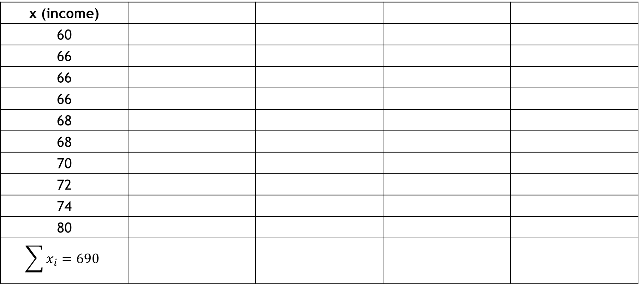
Cont.
$$r=\frac{\sum{x_{i}y_{i}}−\frac{\sum{x_{i}}\sum{y_{i}}}{n}}{\sqrt{\sum{x_{i}^{2}}−\frac{{\left(\sum{x_{i}}\right)}^{2}}{n}} \sqrt{\sum{y_{i}^{2}}−\frac{{\left(\sum{y_{i}}\right)}^{2}}{n}}}$$
x (income)
60
66
66
66
68
68
70
72
74
80
$$\sum{x_{i}}=690$$

Slide 39
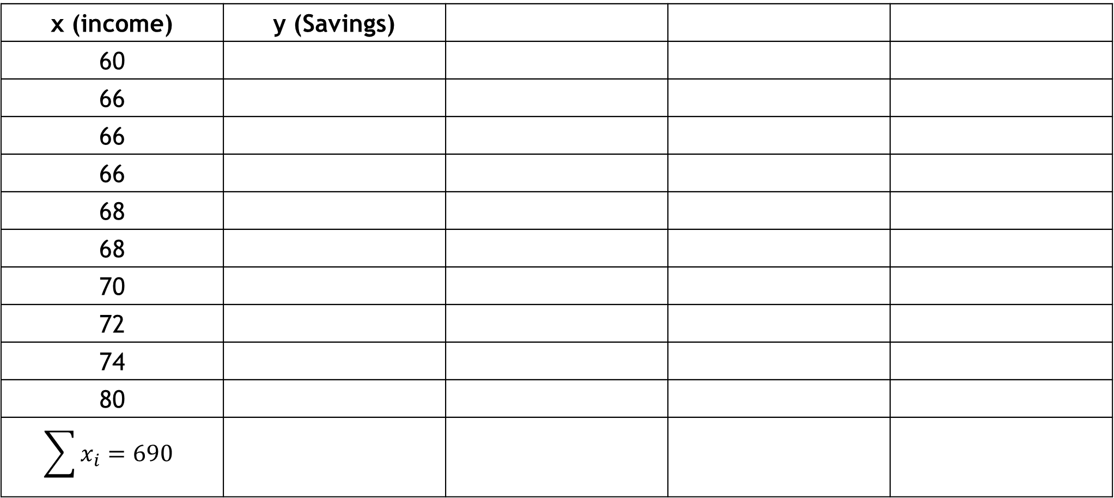
Cont.
$$r=\frac{\sum{x_{i}y_{i}}−\frac{\sum{x_{i}}\sum{y_{i}}}{n}}{\sqrt{\sum{x_{i}^{2}}−\frac{{\left(\sum{x_{i}}\right)}^{2}}{n}} \sqrt{\sum{y_{i}^{2}}−\frac{{\left(\sum{y_{i}}\right)}^{2}}{n}}}$$
x (income) | y (Savings)
60
66
66
66
68
68
70
72
74
80
$$\sum{x_{i}}=690$$

Slide 40
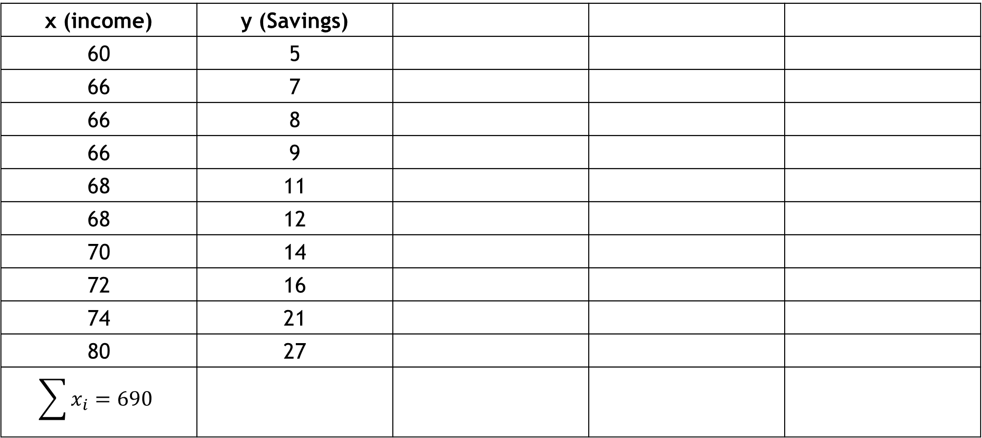
Cont.
$$r=\frac{\sum{x_{i}y_{i}}−\frac{\sum{x_{i}}\sum{y_{i}}}{n}}{\sqrt{\sum{x_{i}^{2}}−\frac{{\left(\sum{x_{i}}\right)}^{2}}{n}} \sqrt{\sum{y_{i}^{2}}−\frac{{\left(\sum{y_{i}}\right)}^{2}}{n}}}$$
x (income) | y (Savings)
60 | 5
66 | 7
66 | 8
66 | 9
68 | 11
68 | 12
70 | 14
72 | 16
74 | 21
80 | 27
$$\sum{x_{i}}=690$$

Slide 41
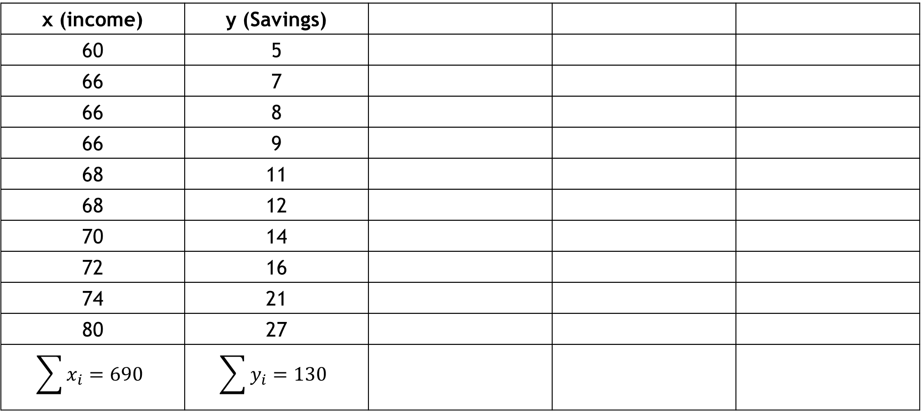
Cont.
$$r=\frac{\sum{x_{i}y_{i}}−\frac{\sum{x_{i}}\sum{y_{i}}}{n}}{\sqrt{\sum{x_{i}^{2}}−\frac{{\left(\sum{x_{i}}\right)}^{2}}{n}} \sqrt{\sum{y_{i}^{2}}−\frac{{\left(\sum{y_{i}}\right)}^{2}}{n}}}$$
x (income) | y (Savings)
60 | 5
66 | 7
66 | 8
66 | 9
68 | 11
68 | 12
70 | 14
72 | 16
74 | 21
80 | 27
$$\sum{x_{i}}=690$$ | $$\sum{y_{i}}=130$$

Slide 42
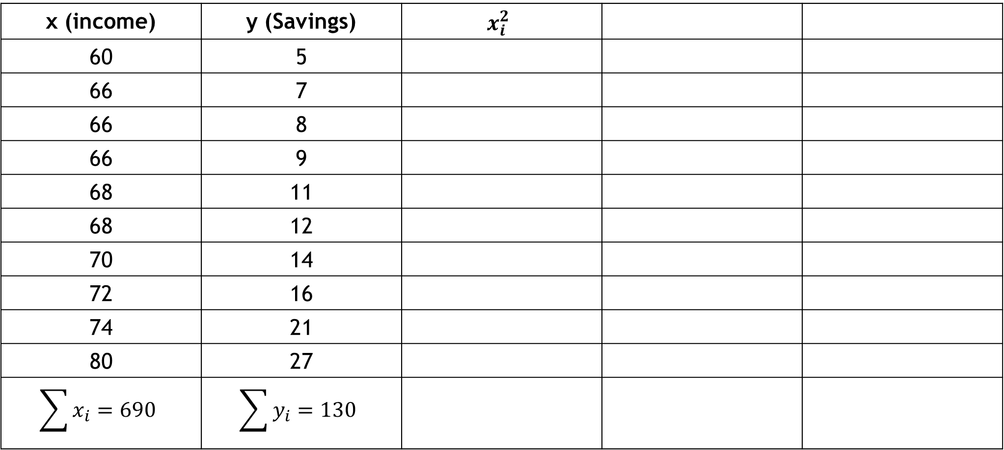
Cont.
$$r=\frac{\sum{x_{i}y_{i}}−\frac{\sum{x_{i}}\sum{y_{i}}}{n}}{\sqrt{\sum{x_{i}^{2}}−\frac{{\left(\sum{x_{i}}\right)}^{2}}{n}} \sqrt{\sum{y_{i}^{2}}−\frac{{\left(\sum{y_{i}}\right)}^{2}}{n}}}$$
x (income) | y (Savings) | $$x_{i}^{2}$$
60 | 5
66 | 7
66 | 8
66 | 9
68 | 11
68 | 12
70 | 14
72 | 16
74 | 21
80 | 27
$$\sum{x_{i}}=690$$ | $$\sum{y_{i}}=130$$

Slide 43
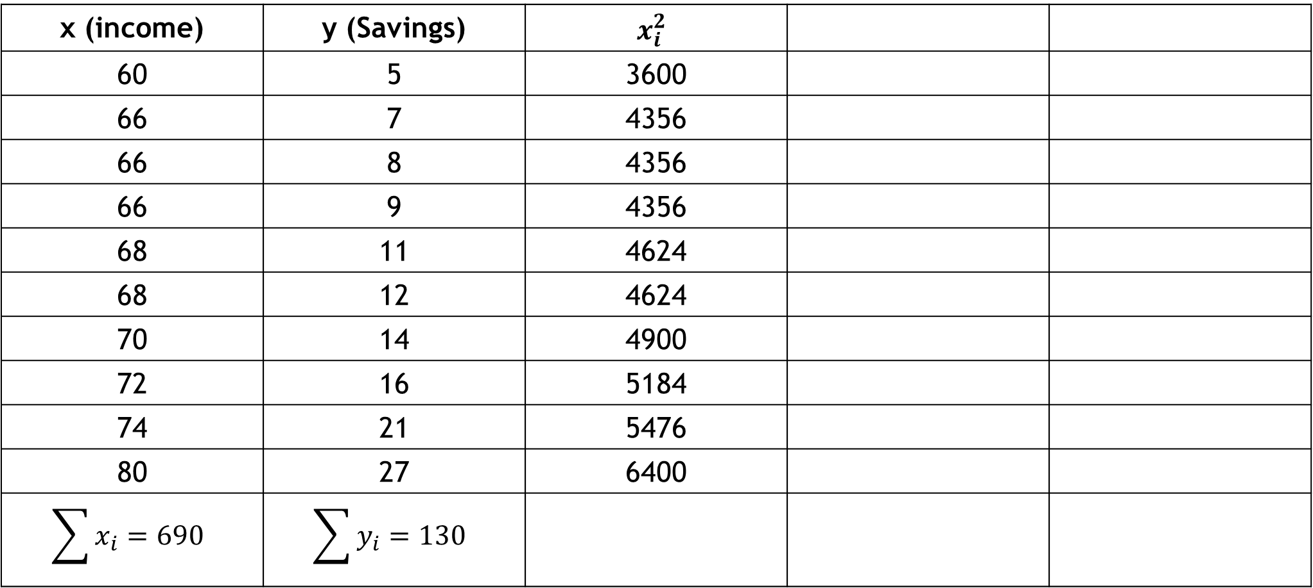
Cont.
$$r=\frac{\sum{x_{i}y_{i}}−\frac{\sum{x_{i}}\sum{y_{i}}}{n}}{\sqrt{\sum{x_{i}^{2}}−\frac{{\left(\sum{x_{i}}\right)}^{2}}{n}} \sqrt{\sum{y_{i}^{2}}−\frac{{\left(\sum{y_{i}}\right)}^{2}}{n}}}$$
x (income) | y (Savings) | $$x_{i}^{2}$$
60 | 5 | 3600
66 | 7 | 4356
66 | 8 | 4356
66 | 9 | 4356
68 | 11 | 4624
68 | 12 | 4624
70 | 14 | 4900
72 | 16 | 5184
74 | 21 | 5476
80 | 27 | 6400
$$\sum{x_{i}}=690$$ | $$\sum{y_{i}}=130$$

Slide 44
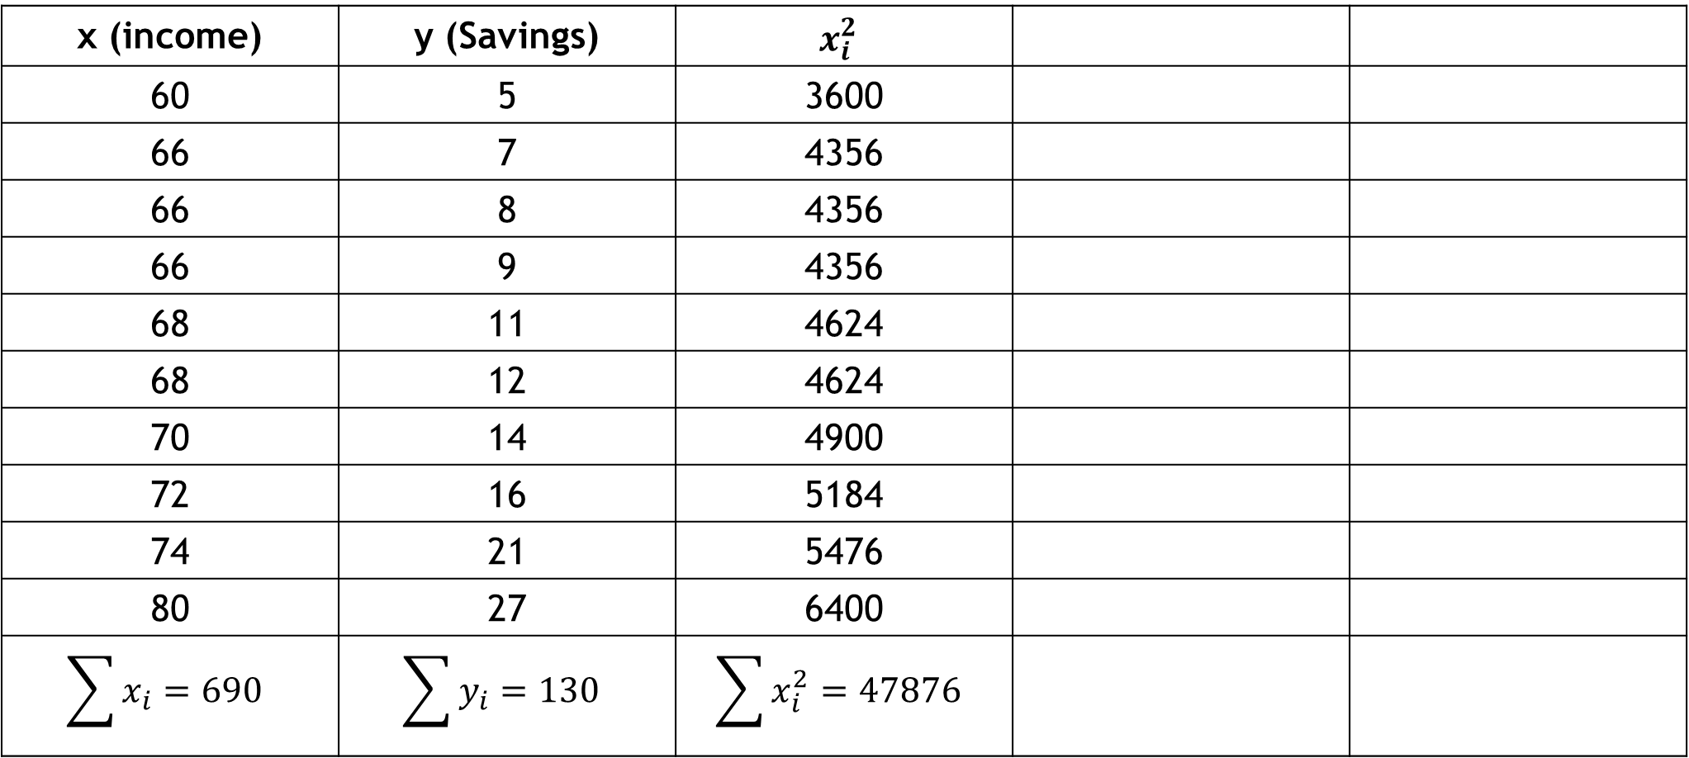
Cont.
$$r=\frac{\sum{x_{i}y_{i}}−\frac{\sum{x_{i}}\sum{y_{i}}}{n}}{\sqrt{\sum{x_{i}^{2}}−\frac{{\left(\sum{x_{i}}\right)}^{2}}{n}} \sqrt{\sum{y_{i}^{2}}−\frac{{\left(\sum{y_{i}}\right)}^{2}}{n}}}$$
x (income) | y (Savings) | $$x_{i}^{2}$$
60 | 5 | 3600
66 | 7 | 4356
66 | 8 | 4356
66 | 9 | 4356
68 | 11 | 4624
68 | 12 | 4624
70 | 14 | 4900
72 | 16 | 5184
74 | 21 | 5476
80 | 27 | 6400
$$\sum{x_{i}}=690$$ | $$\sum{y_{i}}=130$$ | $$\sum{x_{i}^{2}}=47876$$

Slide 45
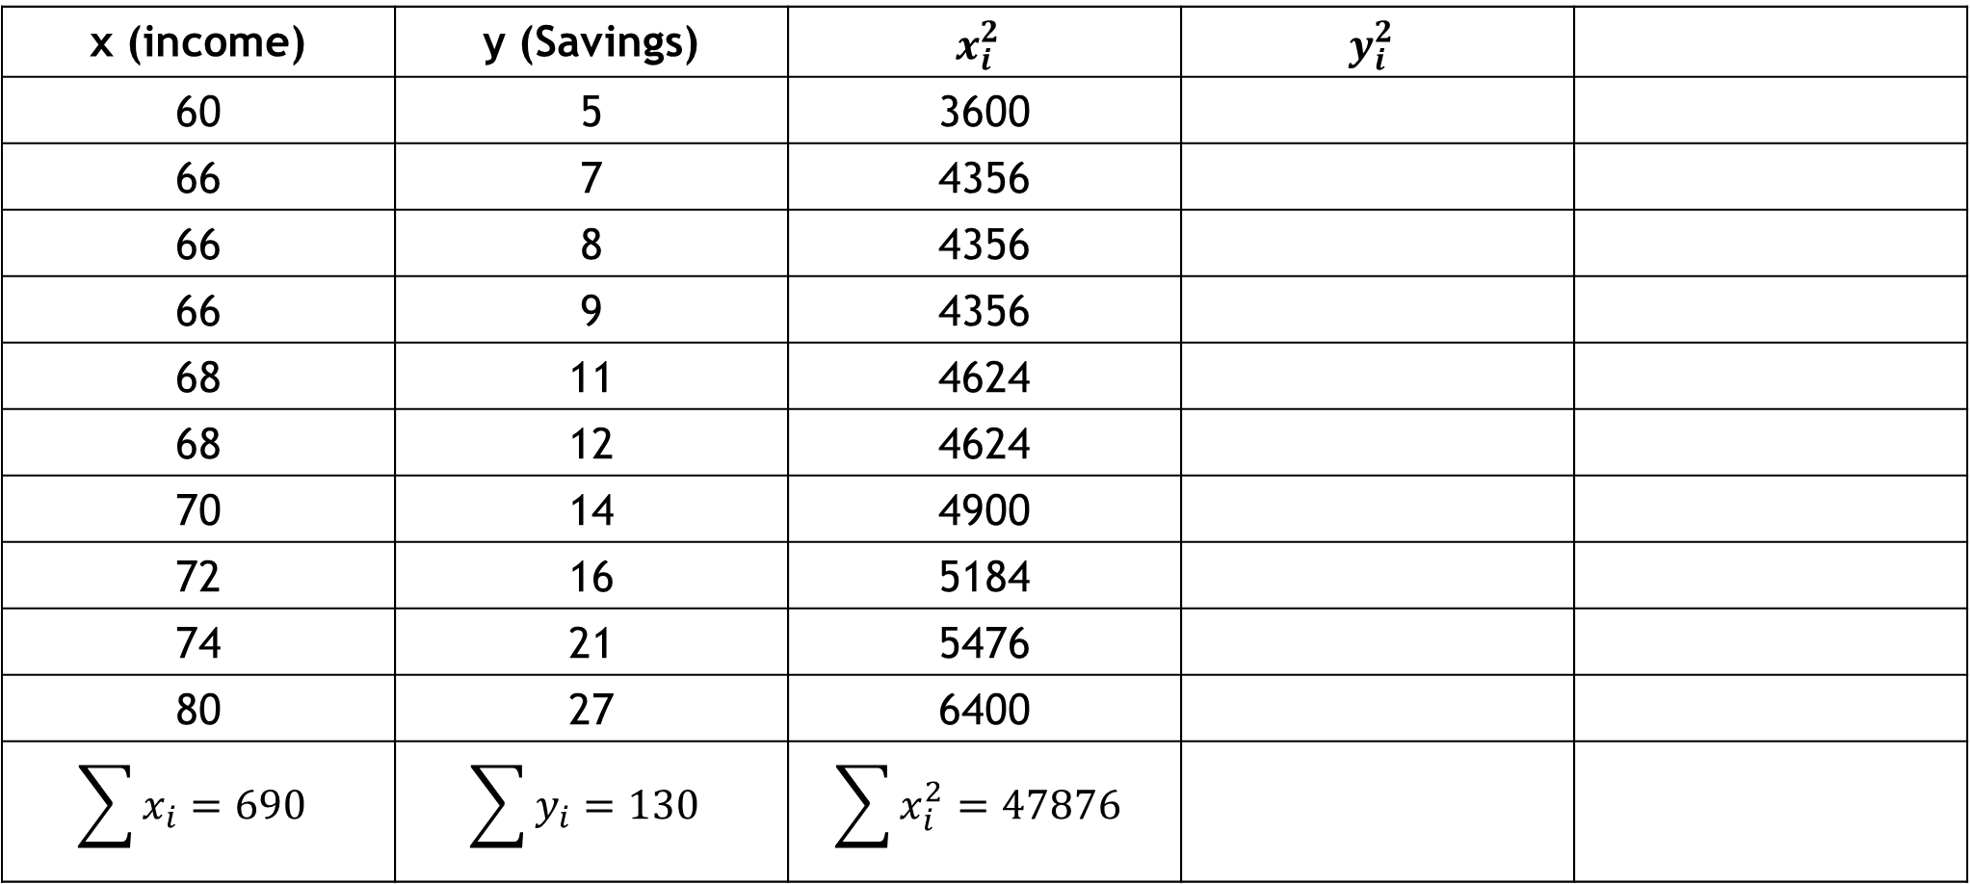
Cont.
$$r=\frac{\sum{x_{i}y_{i}}−\frac{\sum{x_{i}}\sum{y_{i}}}{n}}{\sqrt{\sum{x_{i}^{2}}−\frac{{\left(\sum{x_{i}}\right)}^{2}}{n}} \sqrt{\sum{y_{i}^{2}}−\frac{{\left(\sum{y_{i}}\right)}^{2}}{n}}}$$
x (income) | y (Savings) | $$x_{i}^{2}$$ | $$y_{i}^{2}$$
60 | 5 | 3600
66 | 7 | 4356
66 | 8 | 4356
66 | 9 | 4356
68 | 11 | 4624
68 | 12 | 4624
70 | 14 | 4900
72 | 16 | 5184
74 | 21 | 5476
80 | 27 | 6400
$$\sum{x_{i}}=690$$ | $$\sum{y_{i}}=130$$ | $$\sum{x_{i}^{2}}=47876$$

Slide 46
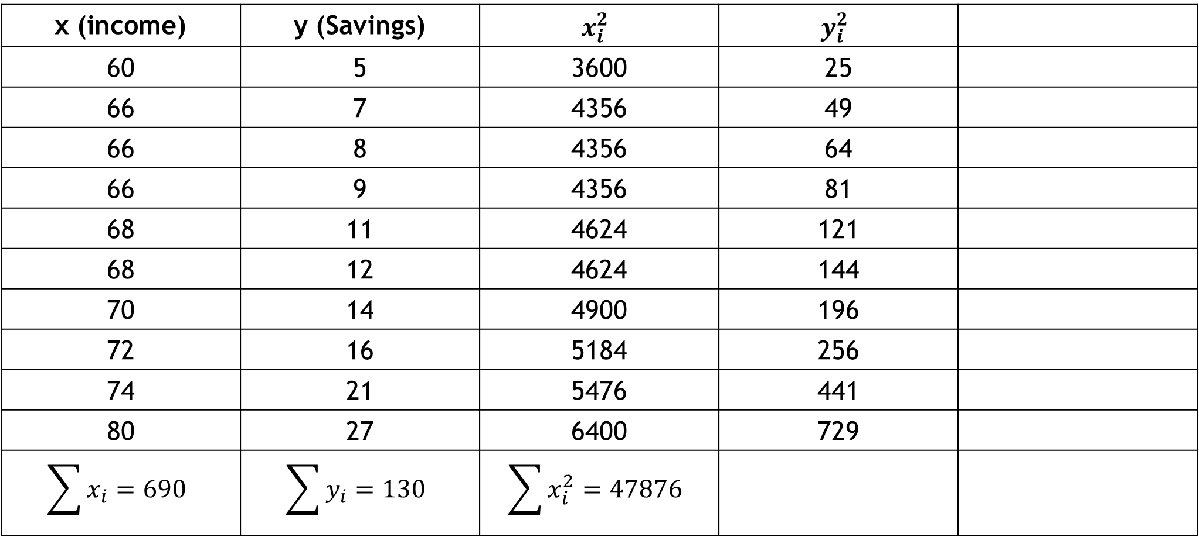
Cont.
$$r=\frac{\sum{x_{i}y_{i}}−\frac{\sum{x_{i}}\sum{y_{i}}}{n}}{\sqrt{\sum{x_{i}^{2}}−\frac{{\left(\sum{x_{i}}\right)}^{2}}{n}} \sqrt{\sum{y_{i}^{2}}−\frac{{\left(\sum{y_{i}}\right)}^{2}}{n}}}$$
x (income) | y (Savings) | $$x_{i}^{2}$$ | $$y_{i}^{2}$$
60 | 5 | 3600 | 25
66 | 7 | 4356 | 49
66 | 8 | 4356 | 64
66 | 9 | 4356 | 81
68 | 11 | 4624 | 121
68 | 12 | 4624 | 144
70 | 14 | 4900 | 196
72 | 16 | 5184 | 256
74 | 21 | 5476 | 441
80 | 27 | 6400 | 729
$$\sum{x_{i}}=690$$ | $$\sum{y_{i}}=130$$ | $$\sum{x_{i}^{2}}=47876$$

Slide 47
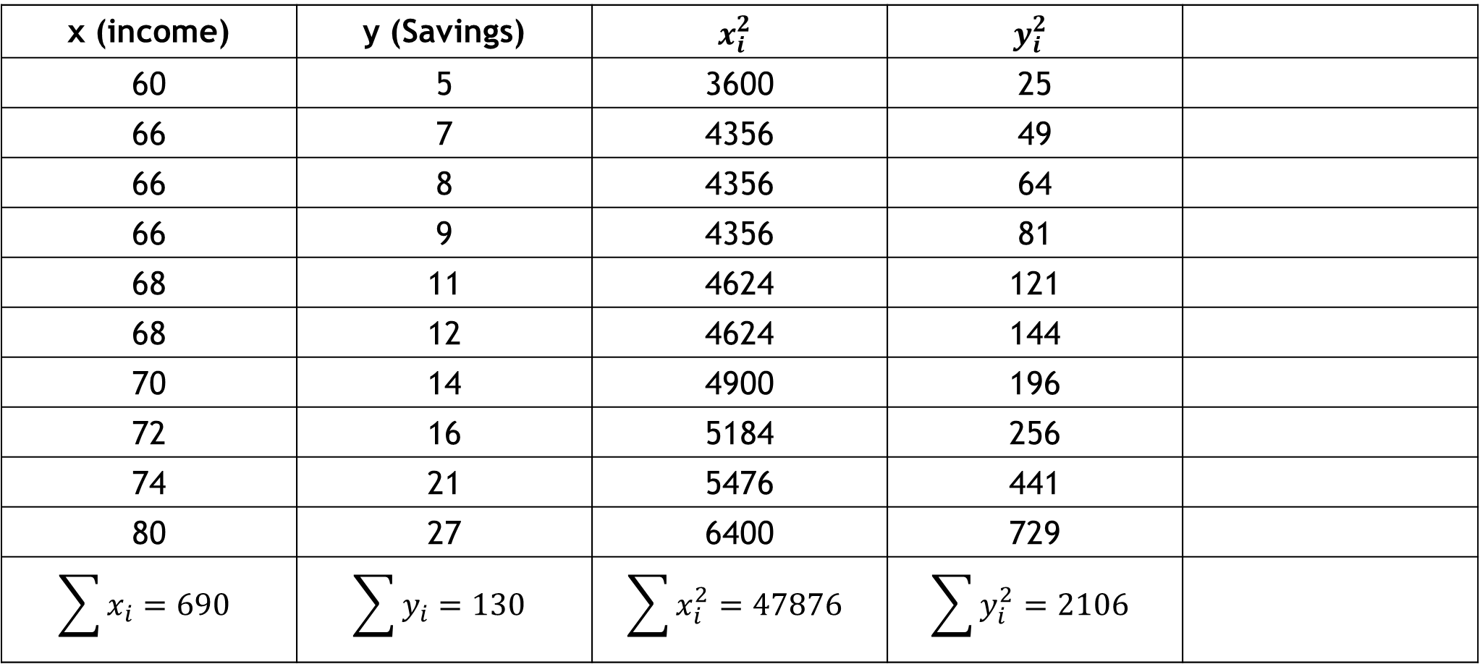
Cont.
$$r=\frac{\sum{x_{i}y_{i}}−\frac{\sum{x_{i}}\sum{y_{i}}}{n}}{\sqrt{\sum{x_{i}^{2}}−\frac{{\left(\sum{x_{i}}\right)}^{2}}{n}} \sqrt{\sum{y_{i}^{2}}−\frac{{\left(\sum{y_{i}}\right)}^{2}}{n}}}$$
x (income) | y (Savings) | $$x_{i}^{2}$$ | $$y_{i}^{2}$$
60 | 5 | 3600 | 25
66 | 7 | 4356 | 49
66 | 8 | 4356 | 64
66 | 9 | 4356 | 81
68 | 11 | 4624 | 121
68 | 12 | 4624 | 144
70 | 14 | 4900 | 196
72 | 16 | 5184 | 256
74 | 21 | 5476 | 441
80 | 27 | 6400 | 729
$$\sum{x_{i}}=690$$ | $$\sum{y_{i}}=130$$ | $$\sum{x_{i}^{2}}=47876$$ | $$\sum{y_{i}^{2}}=2106$$

Slide 48
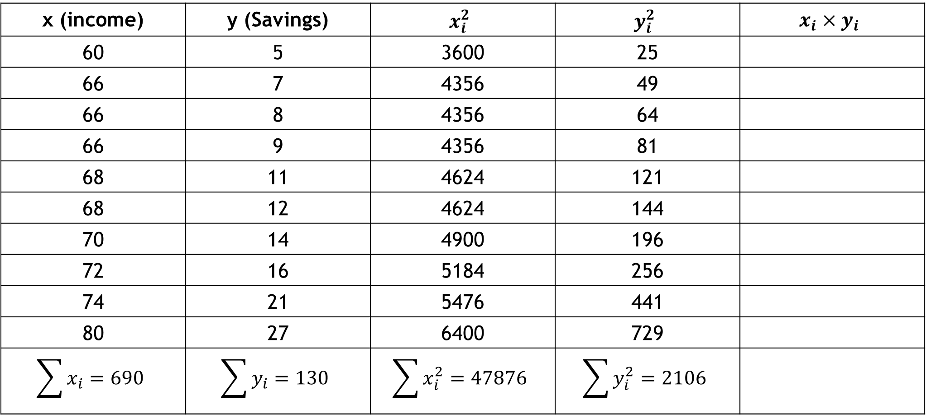
Cont.
$$r=\frac{\sum{x_{i}y_{i}}−\frac{\sum{x_{i}}\sum{y_{i}}}{n}}{\sqrt{\sum{x_{i}^{2}}−\frac{{\left(\sum{x_{i}}\right)}^{2}}{n}} \sqrt{\sum{y_{i}^{2}}−\frac{{\left(\sum{y_{i}}\right)}^{2}}{n}}}$$
x (income) | y (Savings) | $$x_{i}^{2}$$ | $$y_{i}^{2}$$ | $$x_{i}×y_{i}$$
60 | 5 | 3600 | 25
66 | 7 | 4356 | 49
66 | 8 | 4356 | 64
66 | 9 | 4356 | 81
68 | 11 | 4624 | 121
68 | 12 | 4624 | 144
70 | 14 | 4900 | 196
72 | 16 | 5184 | 256
74 | 21 | 5476 | 441
80 | 27 | 6400 | 729
$$\sum{x_{i}}=690$$ | $$\sum{y_{i}}=130$$ | $$\sum{x_{i}^{2}}=47876$$ | $$\sum{y_{i}^{2}}=2106$$

Slide 49
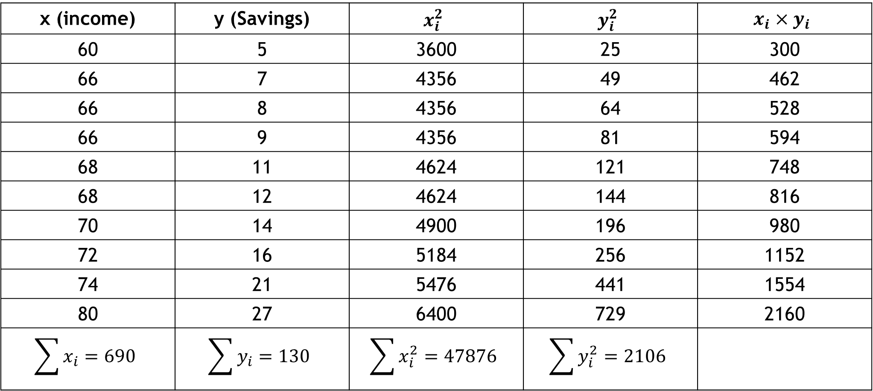
Cont.
$$r=\frac{\sum{x_{i}y_{i}}−\frac{\sum{x_{i}}\sum{y_{i}}}{n}}{\sqrt{\sum{x_{i}^{2}}−\frac{{\left(\sum{x_{i}}\right)}^{2}}{n}} \sqrt{\sum{y_{i}^{2}}−\frac{{\left(\sum{y_{i}}\right)}^{2}}{n}}}$$
x (income) | y (Savings) | $$x_{i}^{2}$$ | $$y_{i}^{2}$$ | $$x_{i}×y_{i}$$
60 | 5 | 3600 | 25 | 300
66 | 7 | 4356 | 49 | 462
66 | 8 | 4356 | 64 | 528
66 | 9 | 4356 | 81 | 594
68 | 11 | 4624 | 121 | 748
68 | 12 | 4624 | 144 | 816
70 | 14 | 4900 | 196 | 980
72 | 16 | 5184 | 256 | 1152
74 | 21 | 5476 | 441 | 1554
80 | 27 | 6400 | 729 | 2160
$$\sum{x_{i}}=690$$ | $$\sum{y_{i}}=130$$ | $$\sum{x_{i}^{2}}=47876$$ | $$\sum{y_{i}^{2}}=2106$$

Slide 50
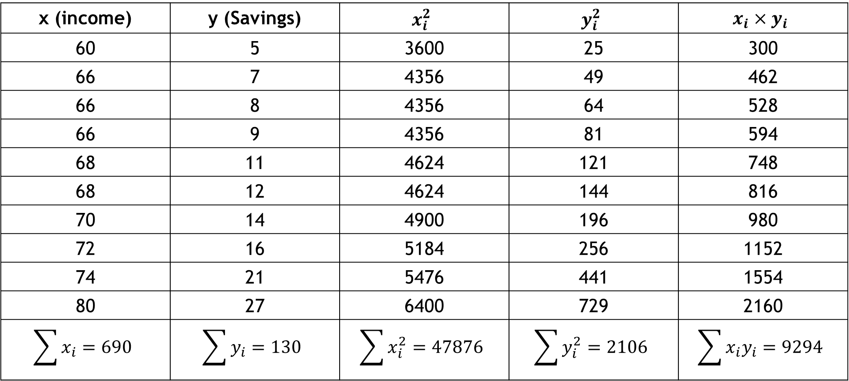
Cont.
$$r=\frac{\sum{x_{i}y_{i}}−\frac{\sum{x_{i}}\sum{y_{i}}}{n}}{\sqrt{\sum{x_{i}^{2}}−\frac{{\left(\sum{x_{i}}\right)}^{2}}{n}} \sqrt{\sum{y_{i}^{2}}−\frac{{\left(\sum{y_{i}}\right)}^{2}}{n}}}$$
x (income) | y (Savings) | $$x_{i}^{2}$$ | $$y_{i}^{2}$$ | $$x_{i}×y_{i}$$
60 | 5 | 3600 | 25 | 300
66 | 7 | 4356 | 49 | 462
66 | 8 | 4356 | 64 | 528
66 | 9 | 4356 | 81 | 594
68 | 11 | 4624 | 121 | 748
68 | 12 | 4624 | 144 | 816
70 | 14 | 4900 | 196 | 980
72 | 16 | 5184 | 256 | 1152
74 | 21 | 5476 | 441 | 1554
80 | 27 | 6400 | 729 | 2160
$$\sum{x_{i}}=690$$ | $$\sum{y_{i}}=130$$ | $$\sum{x_{i}^{2}}=47876$$ | $$\sum{y_{i}^{2}}=2106$$ | $$\sum{x_{i}y_{i}}=9294$$

Slide 51

Cont.
Now, the correlation coefficient
$$r=\frac{\sum{x_{i}y_{i}}−\frac{\sum{x_{i}}\sum{y_{i}}}{n}}{\sqrt{\sum{x_{i}^{2}}−\frac{{\left(\sum{x_{i}}\right)}^{2}}{n}} \sqrt{\sum{y_{i}^{2}}−\frac{{\left(\sum{y_{i}}\right)}^{2}}{n}}}=\frac{9294−\frac{690×130}{10}}{\sqrt{47876−\frac{{\left(690\right)}^{2}}{10}}\sqrt{2106−\frac{{\left(130\right)}^{2}}{10}}}=0.97$$

Slide 52
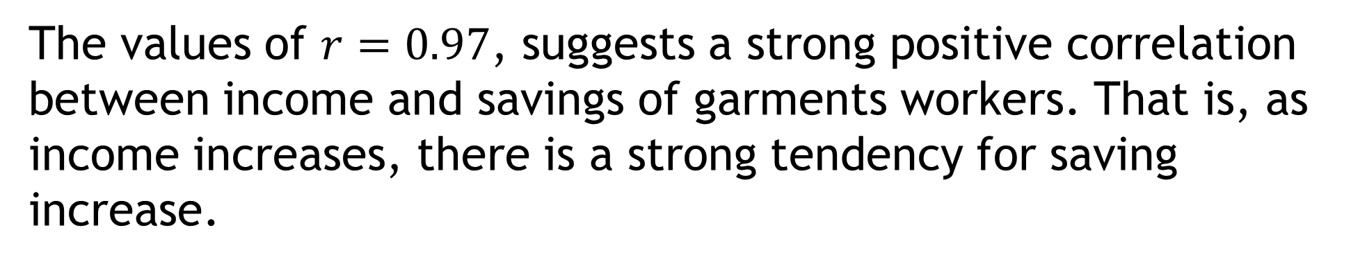
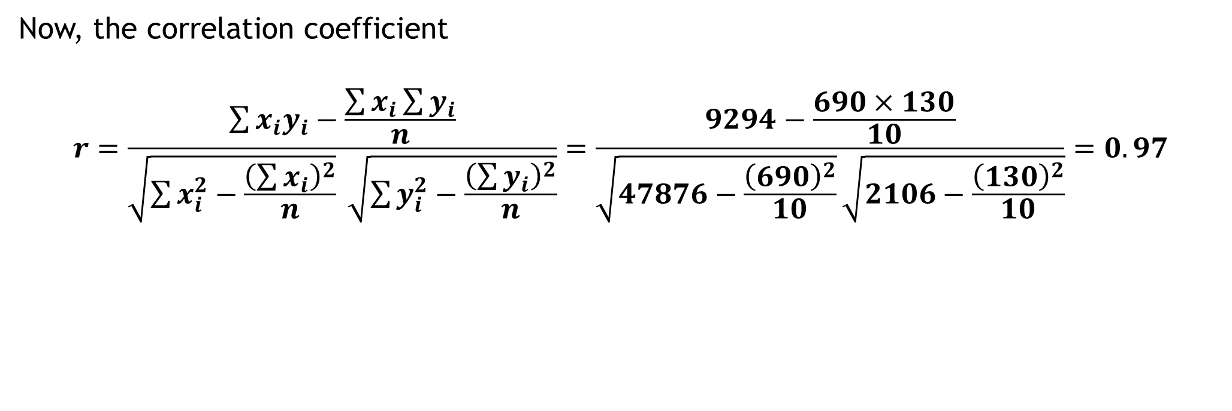
Cont.
Correlation | Negative | Positive
Weak | -0.29 to -0.10 | 0.10 to 0.29
Medium | -0.49 to -0.30 | 0.30 to 0.49
Moderate | -0.50 to -0.79 | 0.50 to 0.79
Strong | -1.00 to -0.80 | 0.80 to 1.00
Now, the correlation coefficient
$$r=\frac{\sum{x_{i}y_{i}}−\frac{\sum{x_{i}}\sum{y_{i}}}{n}}{\sqrt{\sum{x_{i}^{2}}−\frac{{\left(\sum{x_{i}}\right)}^{2}}{n}} \sqrt{\sum{y_{i}^{2}}−\frac{{\left(\sum{y_{i}}\right)}^{2}}{n}}}=\frac{9294−\frac{690×130}{10}}{\sqrt{47876−\frac{{\left(690\right)}^{2}}{10}}\sqrt{2106−\frac{{\left(130\right)}^{2}}{10}}}=0.97$$
The values of $r=0.97$, suggests a strong positive correlation between income and savings of garments workers. That is, as income increases, there is a strong tendency for saving increase.

Slide 53
Thank You

